Slide 1
HW6: Hypothesis Testing 2
Akshaj Kammari

Slide 2
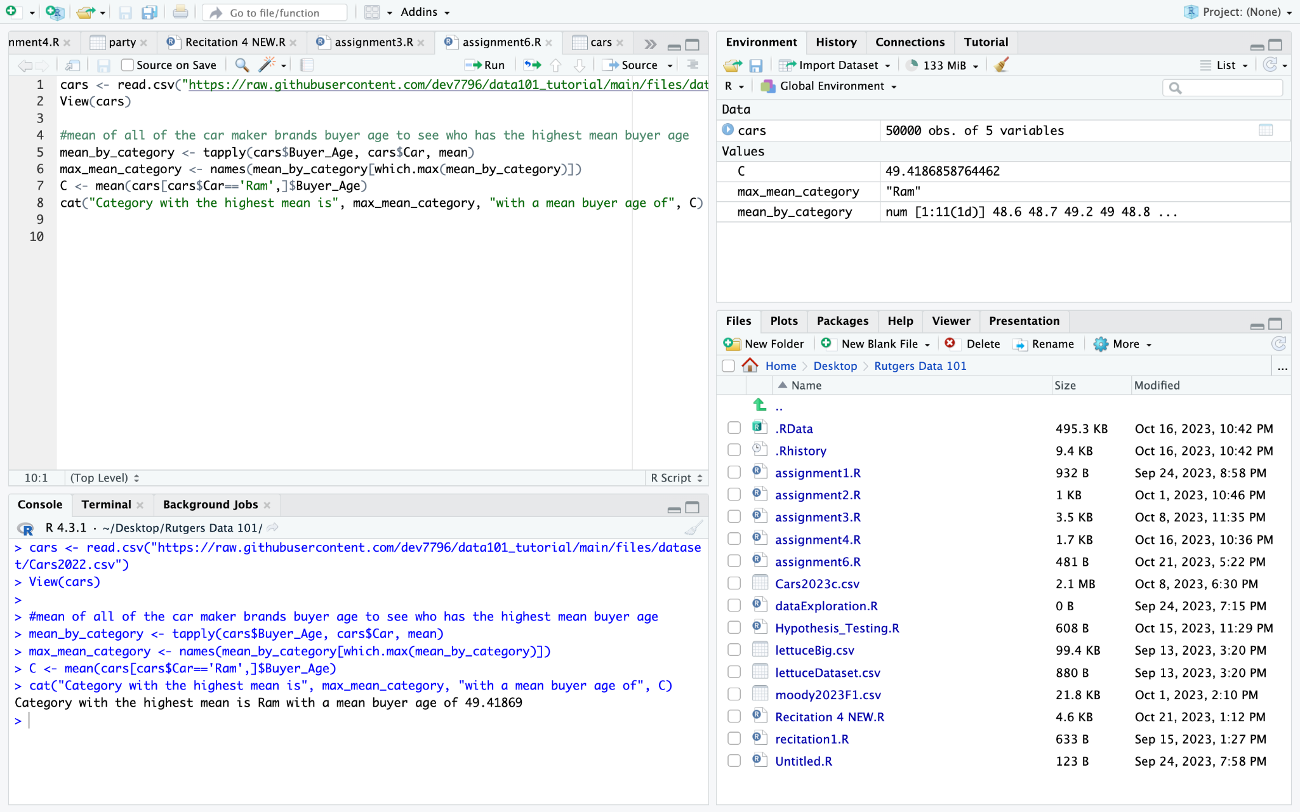
Car maker with the highest mean age of buyers
Mean_by_category calculates the mean for each category using tapply
Max_mean_category identifies the category with the highest mean

Slide 3
P-Test continued
Lower P-Value (p < alpha): If the p-value is significantly lower than the chosen significance level (alpha, typically 0.05), it suggests that the observed difference in mean age between brand "C" and another car maker is unlikely to have occurred by random chance alone. In this context, a lower p-value indicates evidence against the null hypothesis of no difference.
Higher P-Value (p ≥ alpha): If the p-value is greater than or equal to your chosen significance level, it suggests that the observed difference in mean age between brand "C" and another car maker is not statistically significant. In other words, it could have occurred by random chance alone, and there's insufficient evidence to reject the null hypothesis.

Slide 4
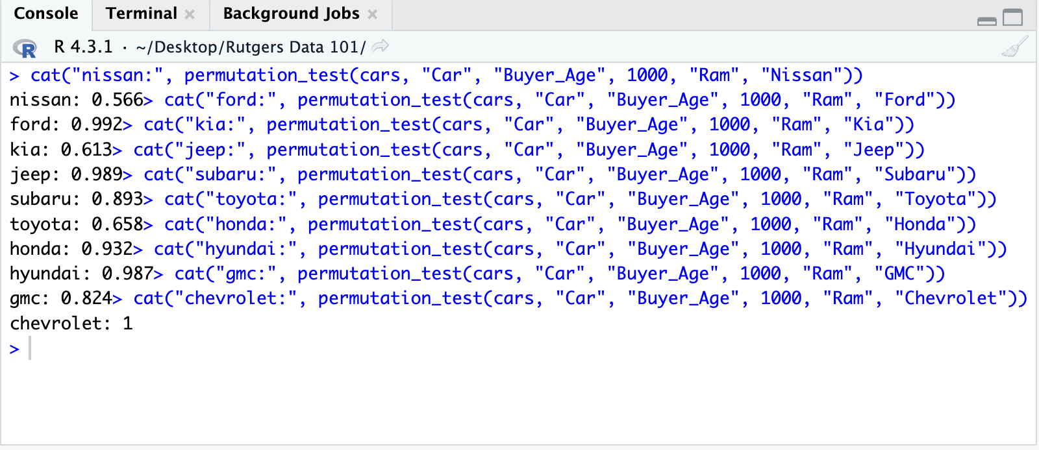
P-Test
A p-value represents the probability of obtaining observed results (or more extreme results) when the null hypothesis is true. In this case, the null hypothesis is that there is no difference in the mean age of buyers between brand "C" (Ram) and any other car maker, and any observed differences are due to random fluctuation, as the P-value is quite high here.

Slide 5
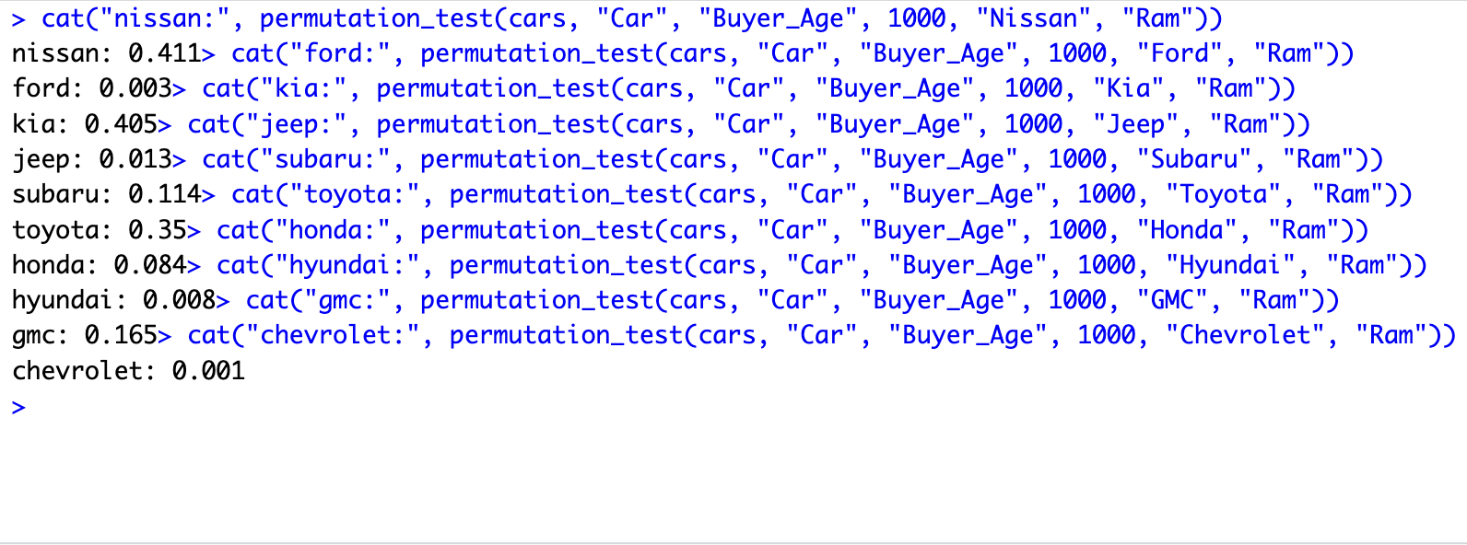
P-Test continued
For curiosity’s sake, lets flip the p-test: instead, let's compare other brands to Ram. We can see there is a drastic difference in most of the p-values, some of them even going under the chosen significance level. This shows there's a low probability of observing the observed difference or more extreme differences under the null hypothesis. In other words, the smaller p-value indicates that there's strong evidence to conclude that some brands may have a higher mean buyer age than Ram, say Ford and Chevrolet for example.

Slide 6
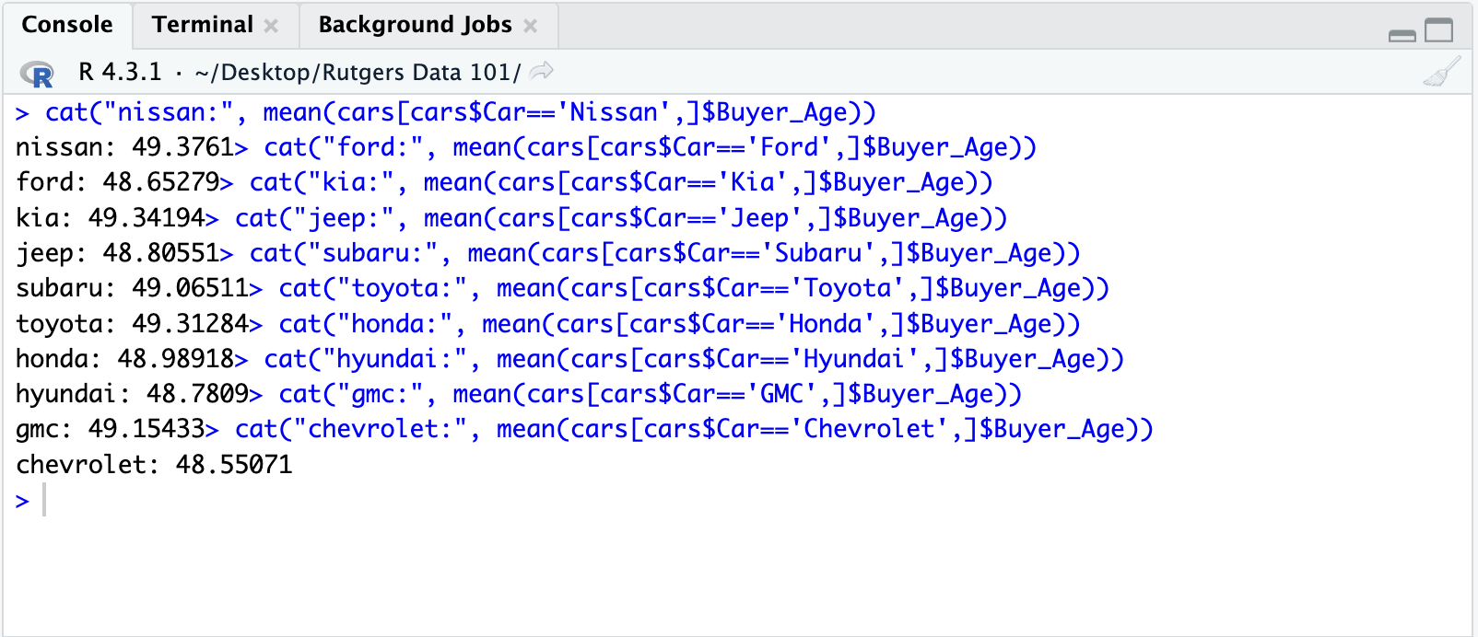
Conclusion
When I manually check each of the other car brands mean buyer age, Ram still has the highest at 49.42. I think it is safe to conclude that C (Ram) does indeed have the highest mean age of buyers.

